Slide 1

CH 1 – Introduction to vectors Worked Examples Section 1
Attribution-NonCommercial-ShareAlike 4.0 International (CC BY-NC-SA 4.0)
Ariel Guerrero Mat. 37877
ariel.guerrero@uc.edu.py
01/05/2020

Slide 2
WE– 1.1.A
Página 6 [Strang,1993]
Problema:
La combinacion lineal de $v=(1,1,0)$ y $w= (0,1,1)$llenan el plano. Describa ese plano.
Encuentre un vector que no sea una combinación lineal de $v$ y $w$.

Slide 3





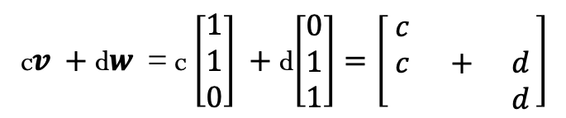
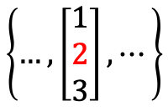
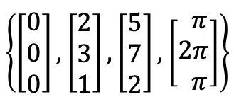
Solución:
La combinacion lineal es un plano en $ℝ^{3}$como en la Figura 1.
$$π$$
c$v +$ d$w$ $∈ ℝ^{3}$
$$v$$
$$w$$
c$v +$ d$w$ = c $\left[\begin{matrix}1 \\ 1 \\ 0\end{matrix}\right] +$ d$\left[\begin{matrix}0 \\ 1 \\ 1\end{matrix}\right]=\left[\begin{matrix}c & & \\ c & + & d \\ & & d\end{matrix}\right]$
Figura 1
$π:\left\{\left(x,y,z\right) | y=x+z\right\} x∈ℝ$, y$∈ℝ$, $z∈ℝ$
El conjunto de vectores tales que el segundo componte
es la suma del primero mas el tercero.
Vectores que
satisfacen la CL
$$\left\{\left[\begin{matrix}0 \\ 0 \\ 0\end{matrix}\right],\left[\begin{matrix}2 \\ 3 \\ 1\end{matrix}\right],\left[\begin{matrix}5 \\ 7 \\ 2\end{matrix}\right],\left[\begin{matrix} π \\ 2π \\ π\end{matrix}\right]\right\}$$
Vectores que NO
satisfacen la CL
$$\left\{…,\left[\begin{matrix}1 \\ 2 \\ 3\end{matrix}\right],⋯\right\}$$
Notes:
Graficos realizados en geogebra, cambiar a tickz

Slide 4
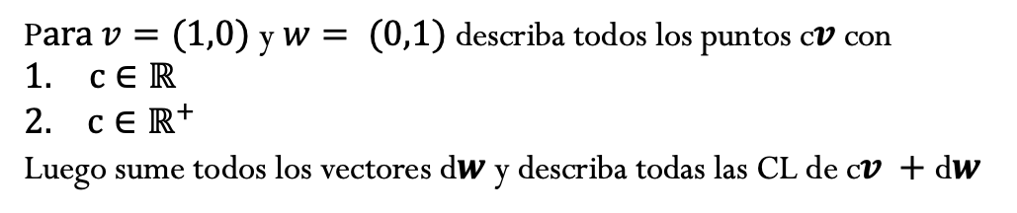
WE– 1.1.B
Página 7 [Strang,1993]
Problema:
P$ara v=(1,0)$ y $w= (0,1)$describa todos los puntos c$v$con
$c∈ℝ$
$c∈ℝ^{+}$
Luego sume todos los vectores d$w$ y describa todas las CL de c$v +$ d$w$

Slide 5
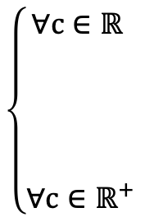



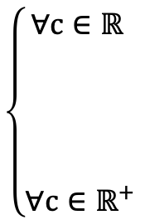



Solución:
y
1)
$$\left\{\begin{aligned}∀c∈ℝ \\ \\ \begin{matrix} \\ \begin{matrix} \\ \end{matrix} \\ ∀c∈ℝ^{+}\end{matrix}\end{aligned}\right.$$
Todo el eje x $⟶$
x
c$v=\text{c} \left[\begin{matrix}1 \\ 0\end{matrix}\right]=\left[\begin{matrix}c \\ 0\end{matrix}\right]$
Todo el eje x⁺ $⟶$
x
y
2)
y
$$\left\{\begin{aligned}∀c∈ℝ \\ \\ \begin{matrix} \\ \begin{matrix} \\ \end{matrix} \\ ∀c∈ℝ^{+}\end{matrix}\end{aligned}\right.$$
Todo el plano xy $⟶$
x
c$v +$ d$w=\left[\begin{matrix}c \\ d\end{matrix}\right]$
y
Semi plano x⁺ $⟶$
x
Notes:
Graficos realizados en geogebra, cambiar a tickz

Slide 6
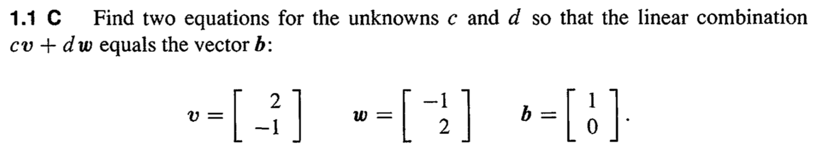
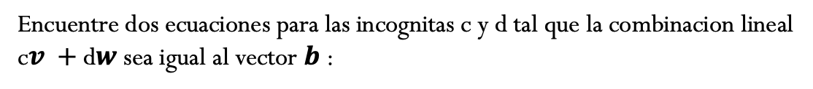
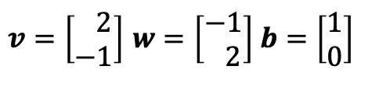
WE– 1.1.C
Página 7 [Strang,1993]
Problema:
Encuentre dos ecuaciones para las incognitas c y d tal que la combinacion lineal
c$v +$ d$w$ sea igual al vector $b$:
$v=\left[\begin{matrix} 2 \\ −1\end{matrix}\right]$ $w=\left[\begin{matrix}−1 \\ 2\end{matrix}\right]$ $b=\left[\begin{matrix}1 \\ 0\end{matrix}\right]$

Slide 7




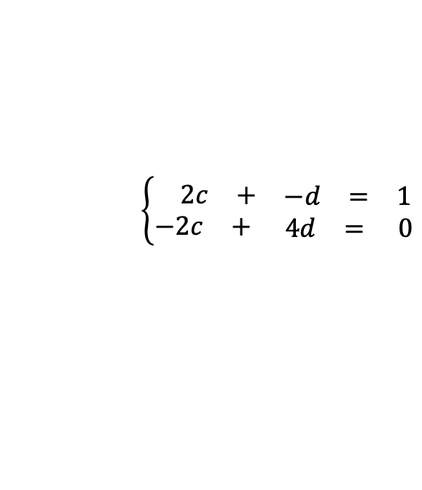




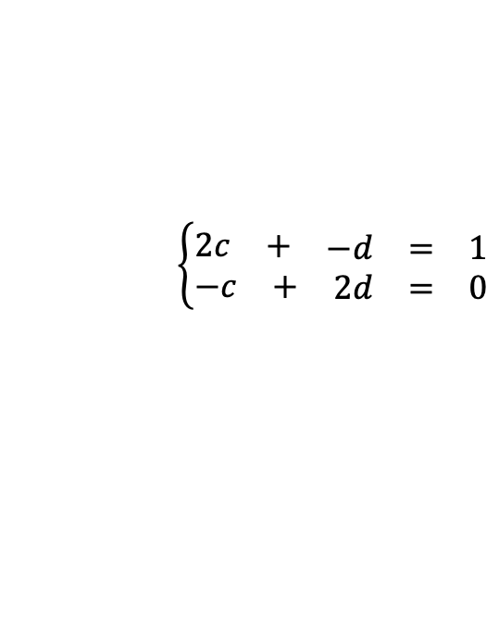
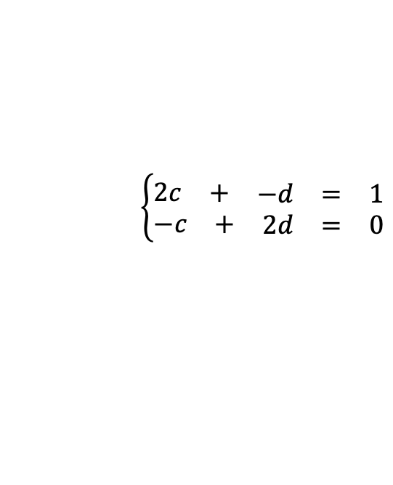


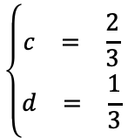
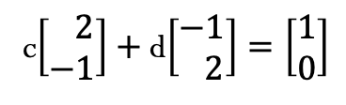

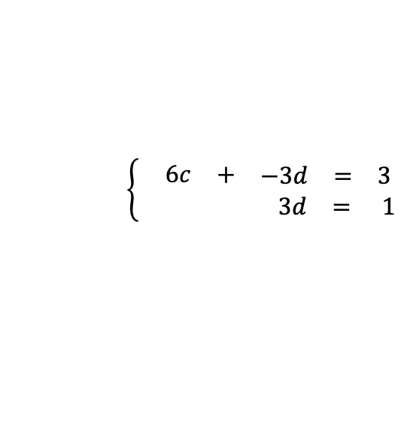
Solución:
c$v +$ d$w=b$
c$\left[\begin{matrix} 2 \\ −1\end{matrix}\right]+$ d$\left[\begin{matrix}−1 \\ 2\end{matrix}\right]=\left[\begin{matrix}1 \\ 0\end{matrix}\right]$
$$⟶$$
$$\left\{\begin{aligned}\begin{matrix}2c & + & \begin{matrix}−d & = & 1\end{matrix}\end{matrix} \\ \begin{matrix}−c & + & \begin{matrix}2d & = & 0\end{matrix}\end{matrix}\end{aligned}\right.$$
Paso 1
$$\left\{\begin{aligned}\begin{matrix}2c & + & \begin{matrix}−d & = & 1\end{matrix}\end{matrix} \\ \begin{matrix}−c & + & \begin{matrix}2d & = & 0\end{matrix}\end{matrix}\end{aligned}\right.$$
$$\left\{\begin{aligned}\begin{matrix} 2c & + & \begin{matrix}−d & = & 1\end{matrix}\end{matrix} \\ \begin{matrix}−2c & + & \begin{matrix} 4d & = & 0\end{matrix}\end{matrix}\end{aligned}\right.$$
$$\left\{\begin{aligned}\begin{matrix} 2c & + & \begin{matrix}−d & = & 1\end{matrix}\end{matrix} \\ \begin{matrix} & & \begin{matrix} 3d & = & 1\end{matrix}\end{matrix}\end{aligned}\right.$$
$$⟶$$
$$⟶$$
$$\begin{matrix}3d & = & 1\end{matrix}$$
$$\begin{matrix}d & = & \frac{1}{3}\end{matrix}$$
Paso 2
$$\left\{\begin{aligned}\begin{matrix} 2c & + & \begin{matrix}−d & = & 1\end{matrix}\end{matrix} \\ \begin{matrix} & & \begin{matrix} 3d & = & 1\end{matrix}\end{matrix}\end{aligned}\right.$$
$$⟶$$
$$\left\{\begin{aligned}\begin{matrix} 6c & + & \begin{matrix}−3d & = & 3\end{matrix}\end{matrix} \\ \begin{matrix} & & \begin{matrix} 3d & = & 1\end{matrix}\end{matrix}\end{aligned}\right.$$
$$⟶$$
$$\begin{matrix}c & = & \frac{2}{3}\end{matrix}$$
$$\begin{matrix}6c & & \begin{matrix} & = & 4\end{matrix}\end{matrix}$$
$$\left\{\begin{aligned}\begin{matrix}c & = & \frac{2}{3}\end{matrix} \\ \begin{matrix}d & = & \frac{1}{3}\end{matrix}\end{aligned}\right.$$
Notes:
Graficos realizados en geogebra, cambiar a tickz

Slide 8
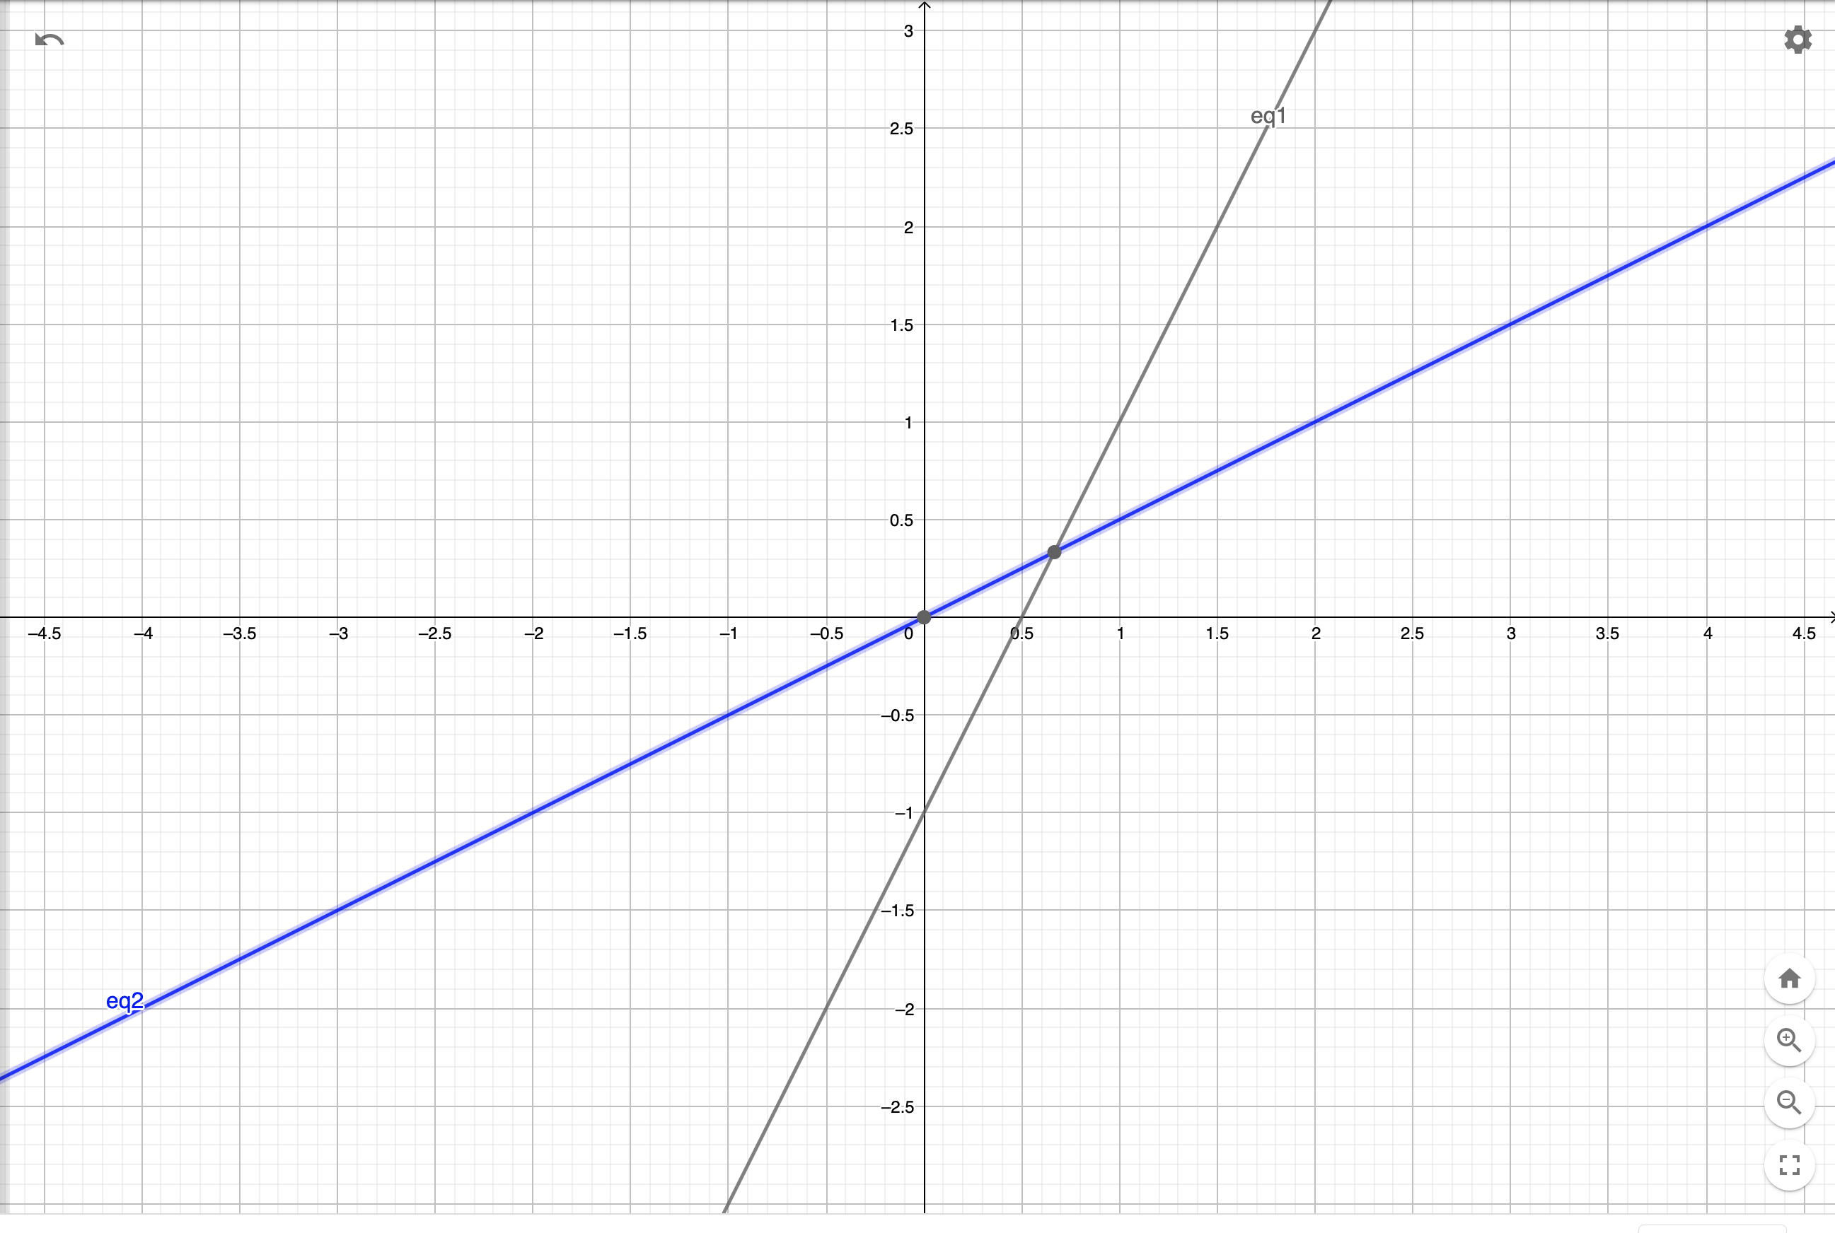
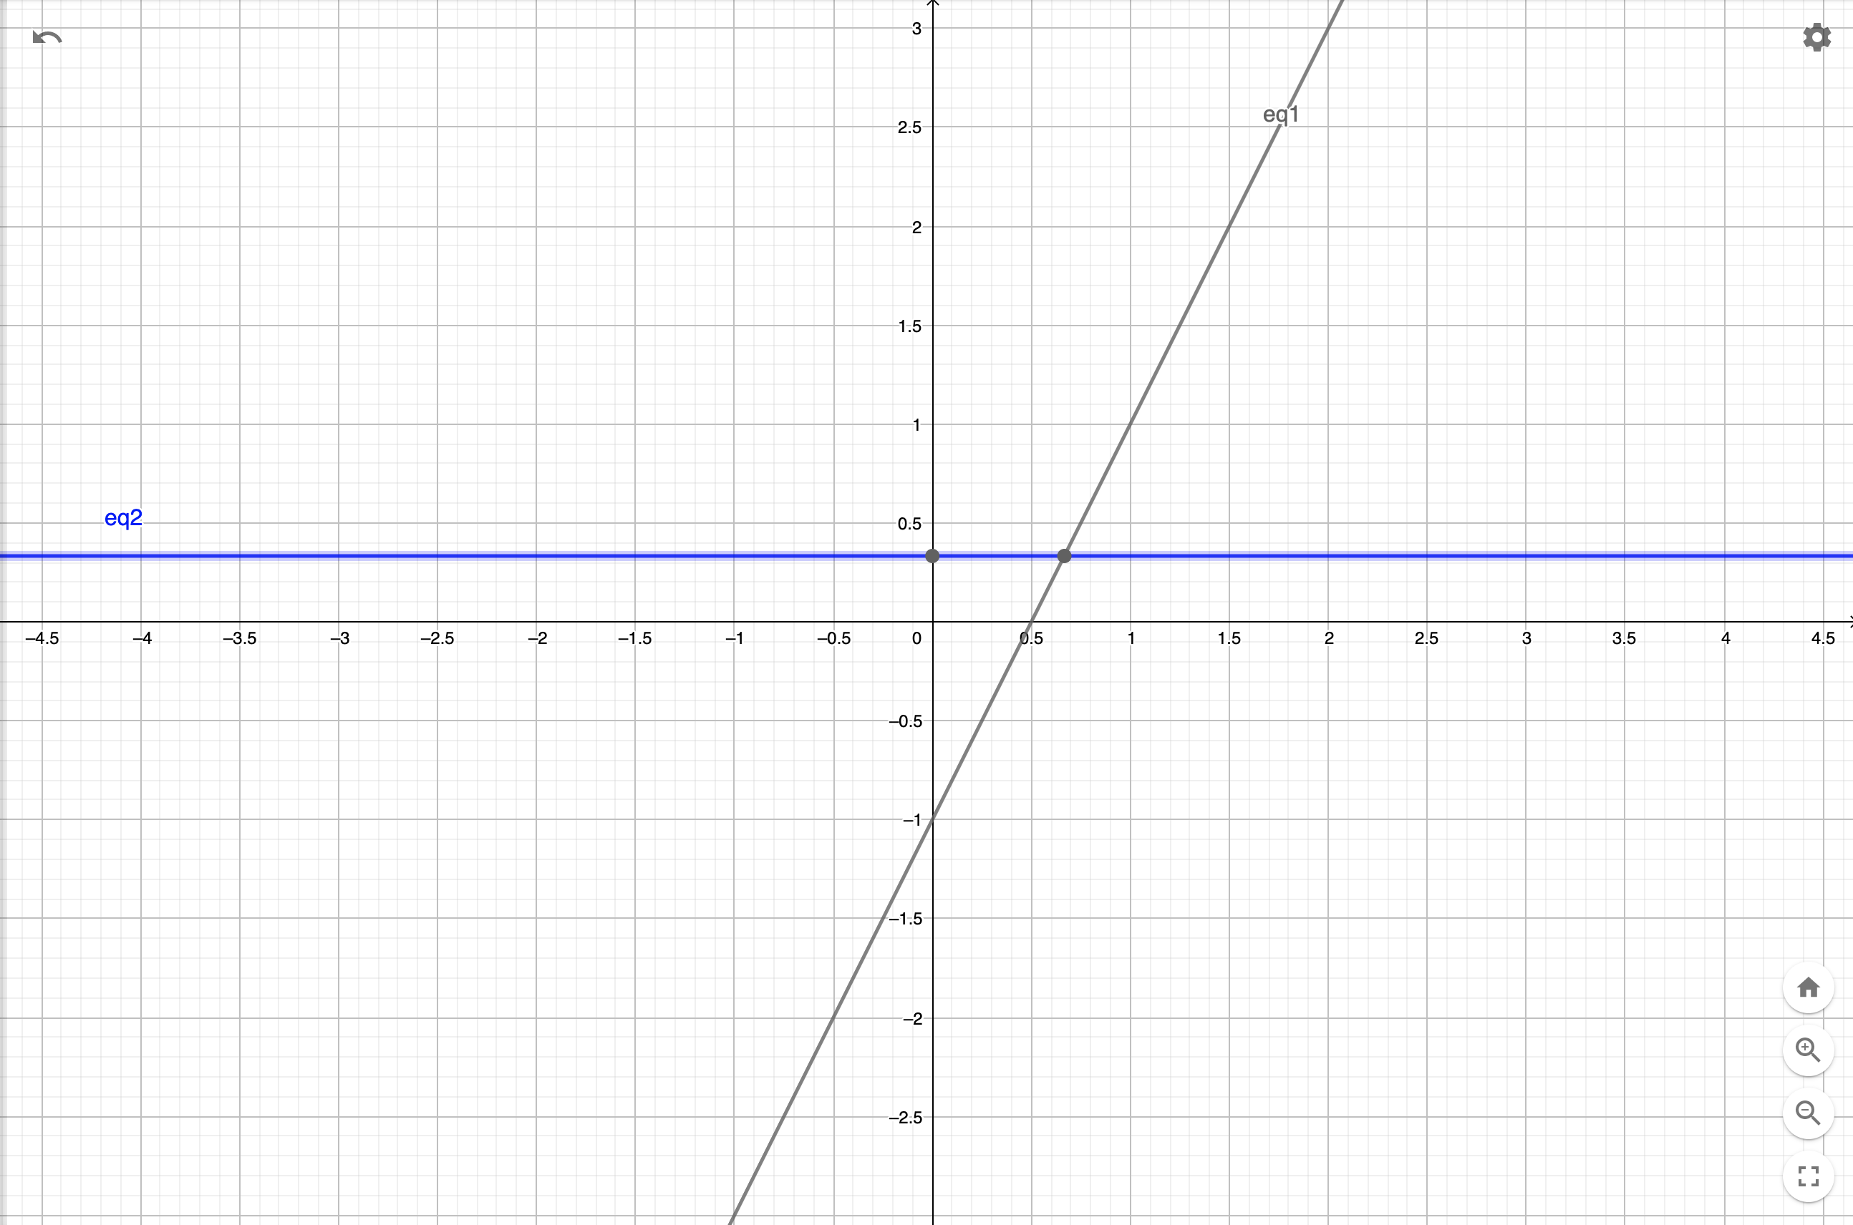
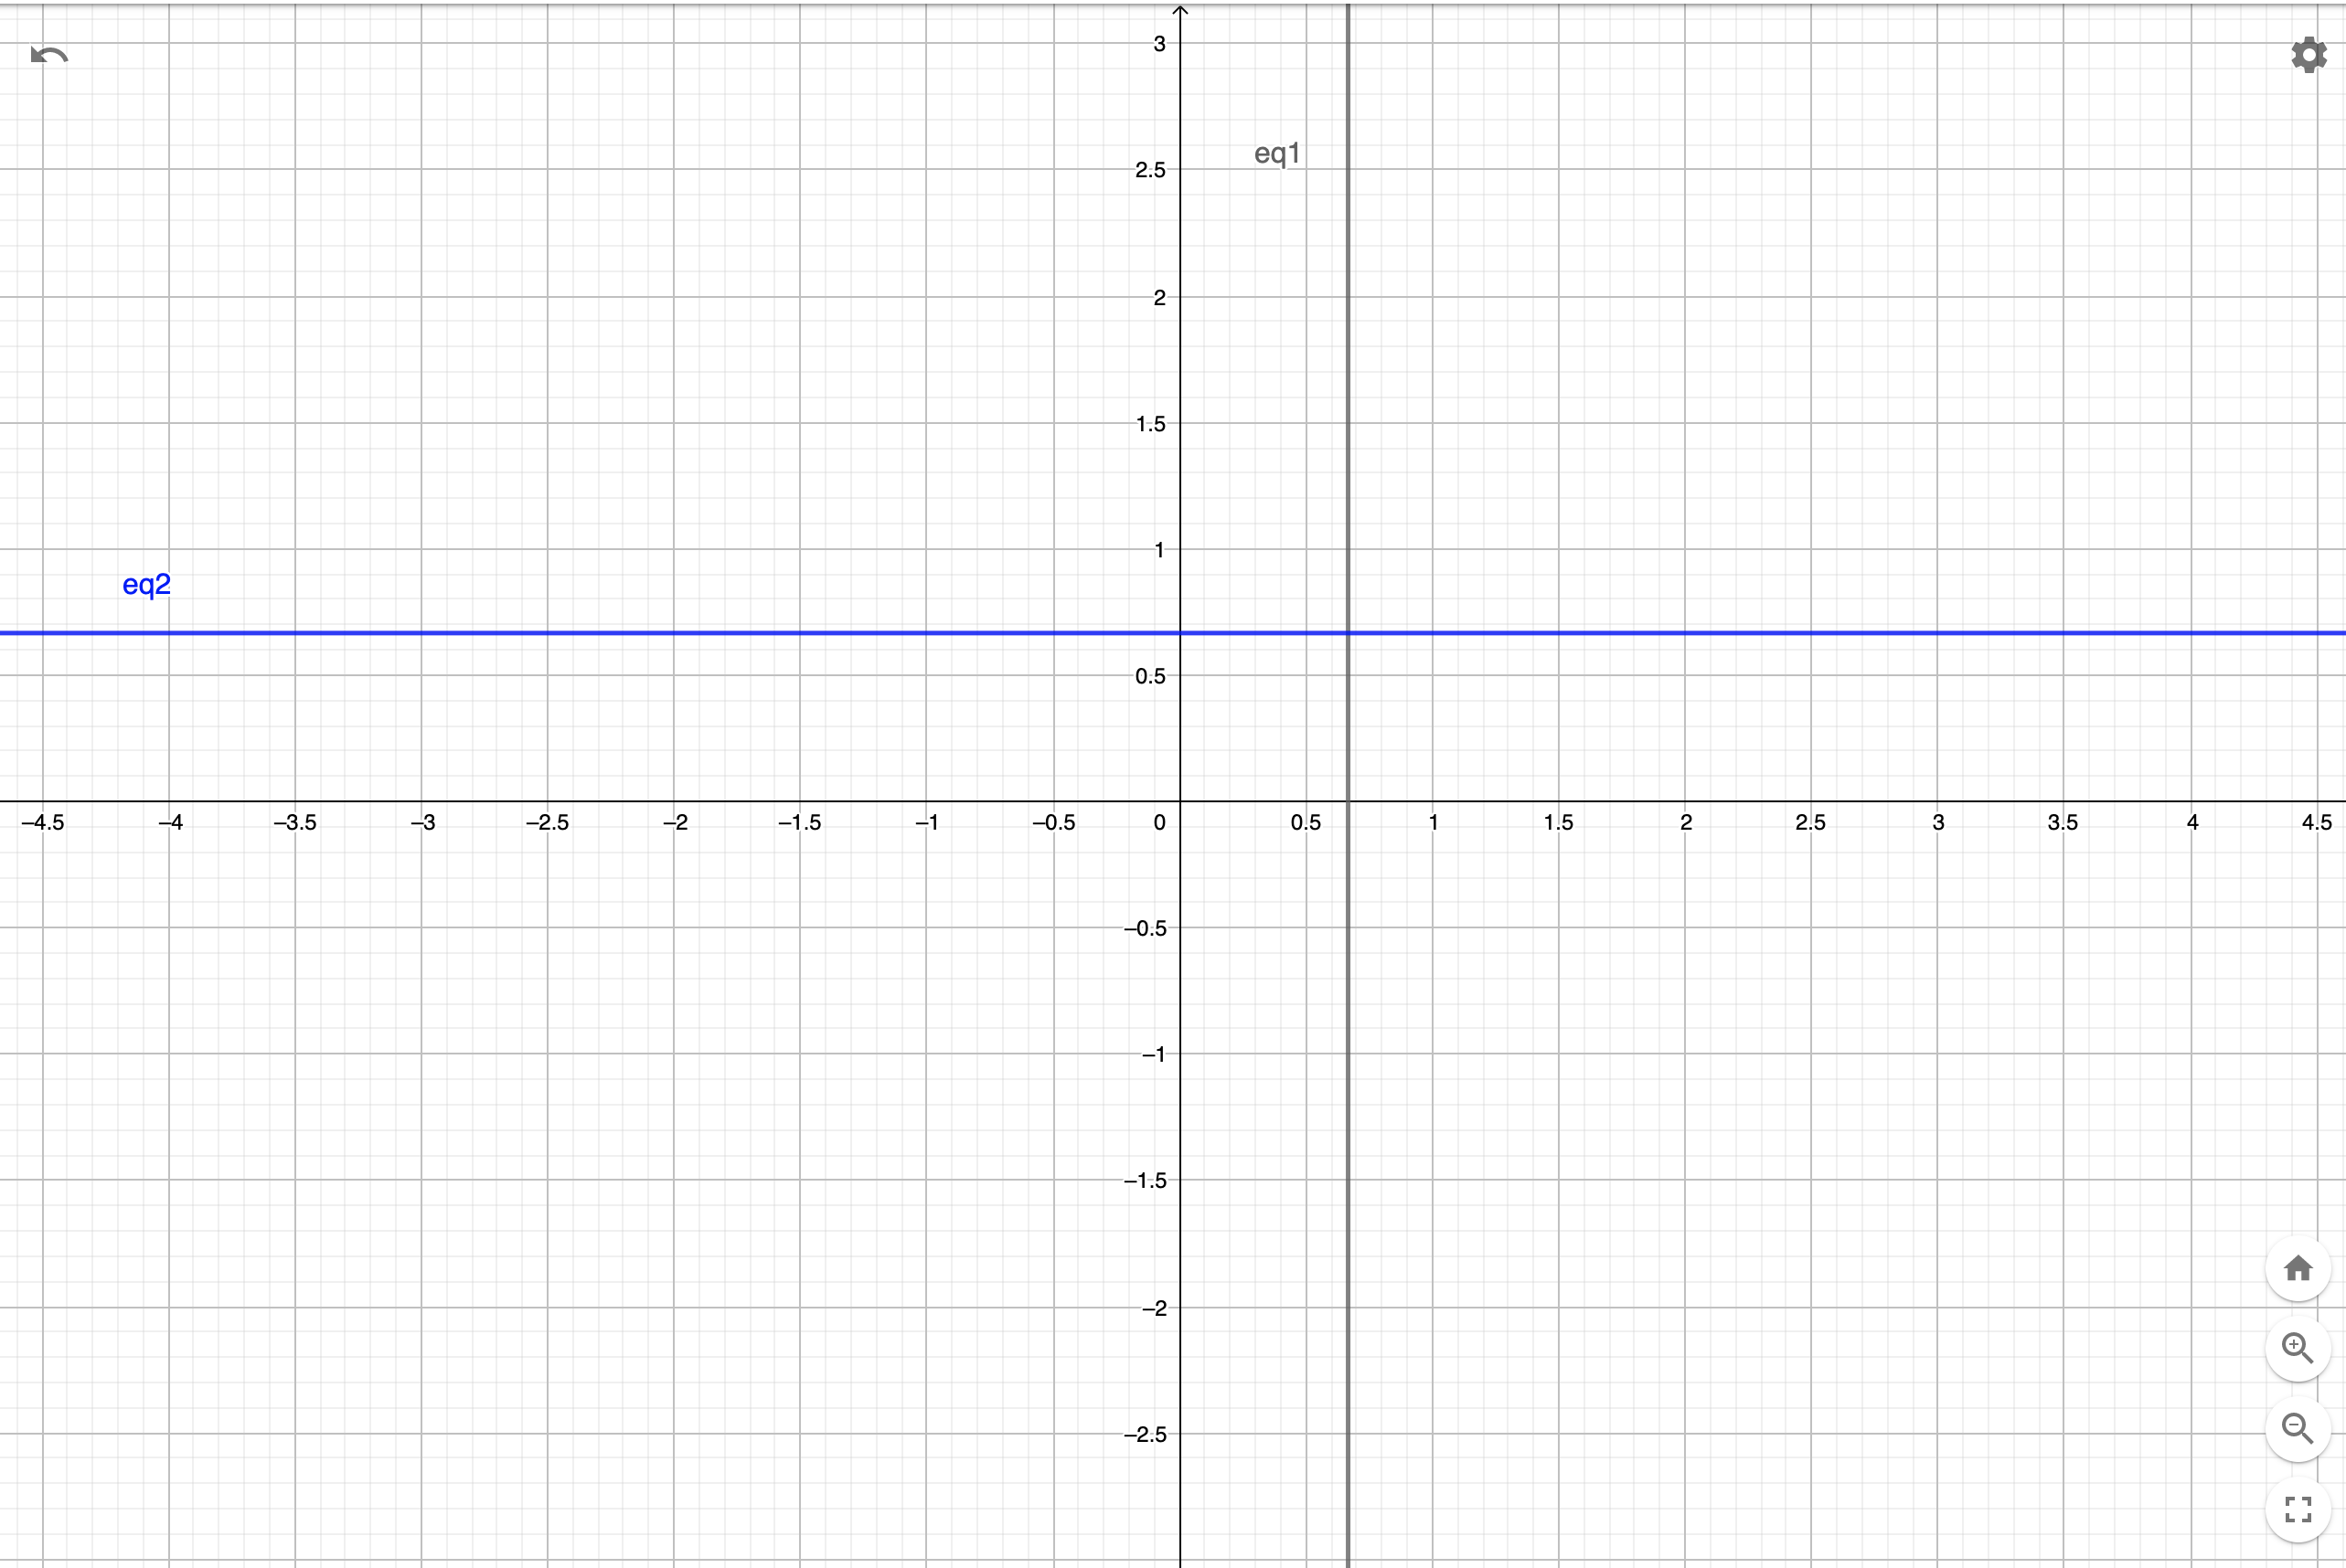
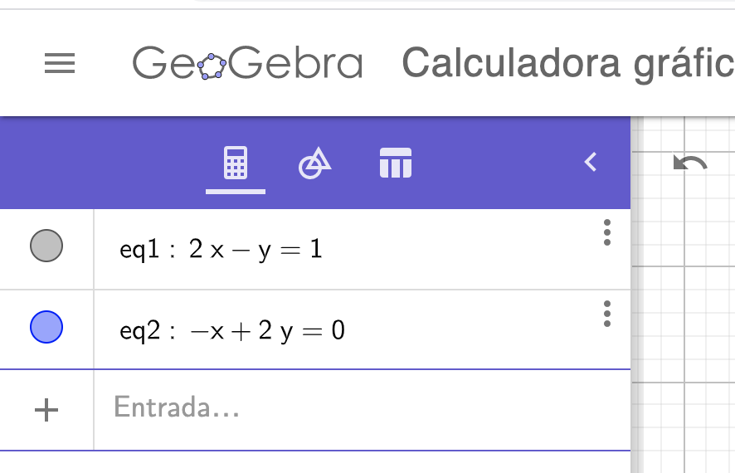
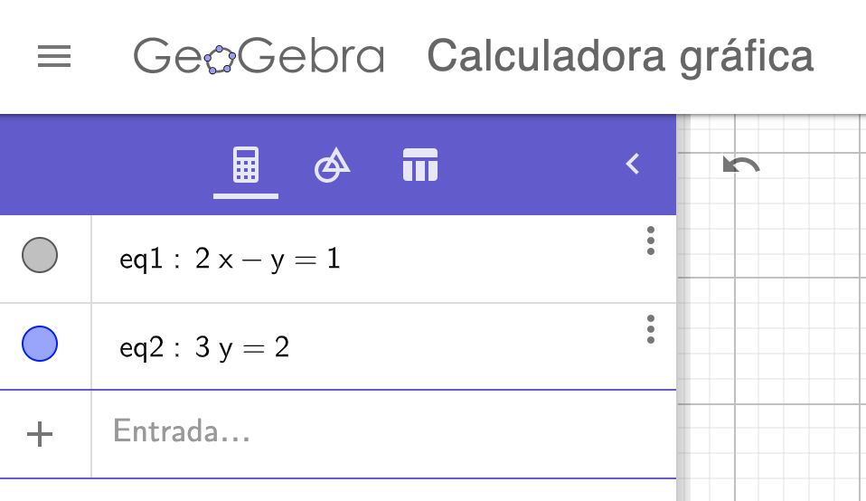

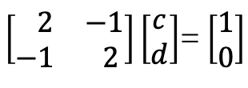


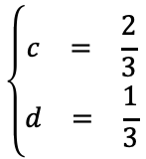
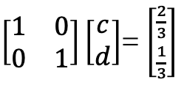
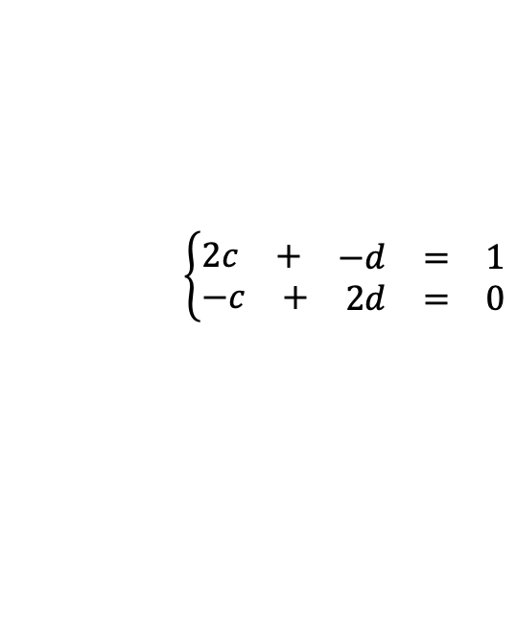
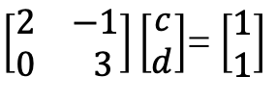
Solución:
Paso 1
Paso 2
$$\left\{\begin{aligned}\begin{matrix}c & = & \frac{2}{3}\end{matrix} \\ \begin{matrix}d & = & \frac{1}{3}\end{matrix}\end{aligned}\right.$$
$$\left\{\begin{aligned}\begin{matrix}2c & + & \begin{matrix}−d & = & 1\end{matrix}\end{matrix} \\ \begin{matrix}−c & + & \begin{matrix}2d & = & 0\end{matrix}\end{matrix}\end{aligned}\right.$$
$$⟶$$
$$\left\{\begin{aligned}\begin{matrix} 2c & + & \begin{matrix}−d & = & 1\end{matrix}\end{matrix} \\ \begin{matrix} & & \begin{matrix} 3d & = & 1\end{matrix}\end{matrix}\end{aligned}\right.$$
$$⟶$$
$\left[\begin{matrix} 2 & −1 \\ −1 & 2\end{matrix}\right]\left[\begin{matrix}c \\ d\end{matrix}\right]$= $\left[\begin{matrix}1 \\ 0\end{matrix}\right]$
$\left[\begin{matrix}2 & −1 \\ 0 & 3\end{matrix}\right]\left[\begin{matrix}c \\ d\end{matrix}\right]$= $\left[\begin{matrix}1 \\ 1\end{matrix}\right]$
$\left[\begin{matrix}1 & 0 \\ 0 & 1\end{matrix}\right]\left[\begin{matrix}c \\ d\end{matrix}\right]$= $\left[\begin{matrix}\frac{2}{3} \\ \frac{1}{3}\end{matrix}\right]$
Notes:
Graficos realizados en geogebra, cambiar a tickz

Slide 9
Credits
Ariel Guerrero
ariel.guerrero@uc.edu.py
(+595) 981-425 040
Hernandarias – Paraguay
@2020
Attribution-NonCommercial-ShareAlike 4.0 International (CC BY-NC-SA 4.0)
GitHub
https://github.com/aegiloru/linearAlgebra
MIT 18.06
https://ocw.mit.edu/courses/mathematics/18-06-linear-algebra-spring-2010/
Prof. Gilbert Strang
http://www-math.mit.edu/~gs/
Strang, G., Strang, G., Strang, G., & Strang, G. (1993).
Introduction to linear algebra (Vol. 3).
Wellesley, MA: Wellesley-Cambridge Press.
[Strang,1993]

